Slide 1
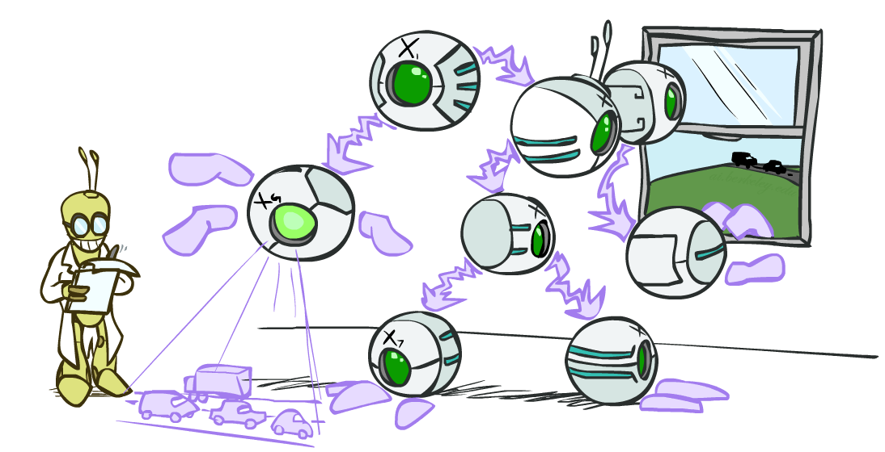
CS 188: Artificial Intelligence
Bayes Nets: Exact Inference
Instructor: Stuart Russell and Peyrin Kao
Notes:
Please retain proper attribution, including the reference to ai.berkeley.edu. Thanks!

Slide 2

Inference by Enumeration in Bayes Net
Reminder of inference by enumeration:
Any probability of interest can be computed by summing entries from the joint distribution: P(Q | e) = α ∑_{h} P(Q , h, e)
Entries from the joint distribution can be obtained from a BN by multiplying the corresponding conditional probabilities
P(B | j, m) = α ∑_{e,a} P(B, e, a, j, m)
= α ∑_{e,a} P(B) P(e) P(a|B,e) P(j|a) P(m|a)
So inference in Bayes nets means computing sums of products of numbers: sounds easy!!
Problem: sums of exponentially many products!
B
E
A
J
M

Slide 3
Can we do better?
Consider uwy + uwz + uxy + uxz + vwy + vwz + vxy +vxz
16 multiplies, 7 adds
Lots of repeated subexpressions!
Rewrite as (u+v)(w+x)(y+z)
2 multiplies, 3 adds
∑_{e,a} P(B) P(e) P(a|B,e) P(j|a) P(m|a)
= P(B)P(e)P(a|B,e)P(j|a)P(m|a) + P(B)P(¬e)P(a|B,¬e)P(j|a)P(m|a)
+ P(B)P(e)P(¬a|B,e)P(j|¬a)P(m|¬a) + P(B)P(¬e)P(¬a|B,¬e)P(j|¬a)P(m|¬a)
Lots of repeated subexpressions!

Slide 4
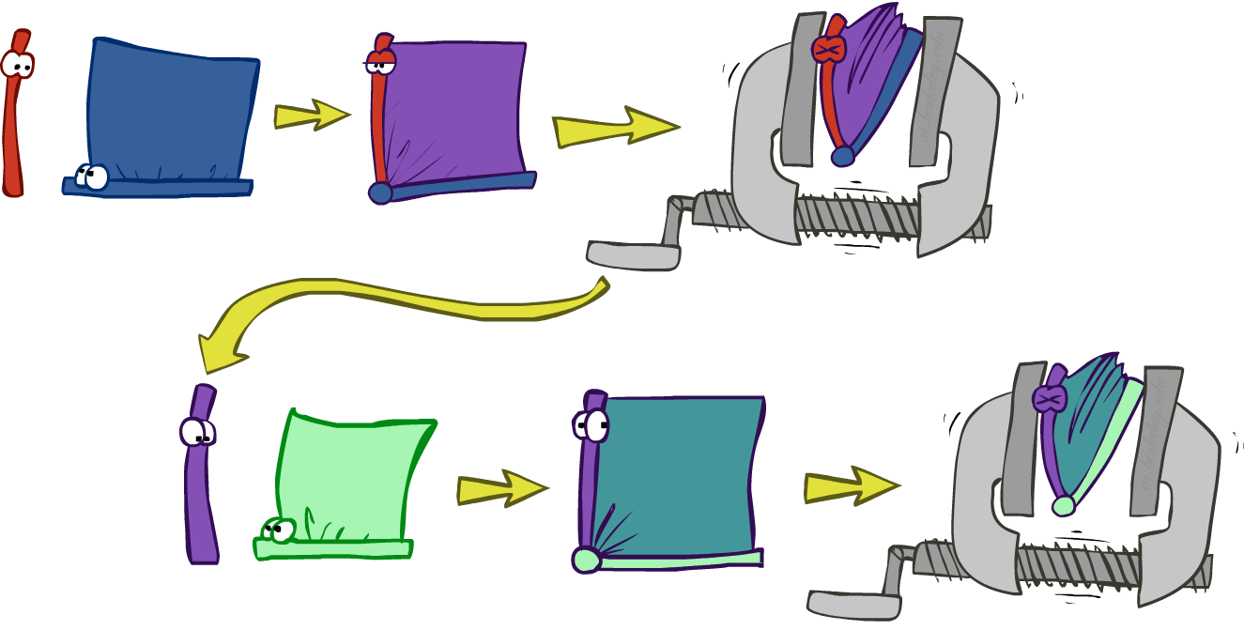
Variable elimination: The basic ideas
Move summations inwards as far as possible
P(B | j, m) = α ∑_{e,a} P(B) P(e) P(a|B,e) P(j|a) P(m|a)
= α P(B) ∑_{e} P(e) ∑_{a} P(a|B,e) P(j|a) P(m|a)
Do the calculation from the inside out
I.e., sum over a first, then sum over e
Problem: P(a|B,e) isn’t a single number, it’s a bunch of different numbers depending on the values of B and e
Solution: use arrays of numbers (of various dimensions) with appropriate operations on them; these are called factors

Slide 5
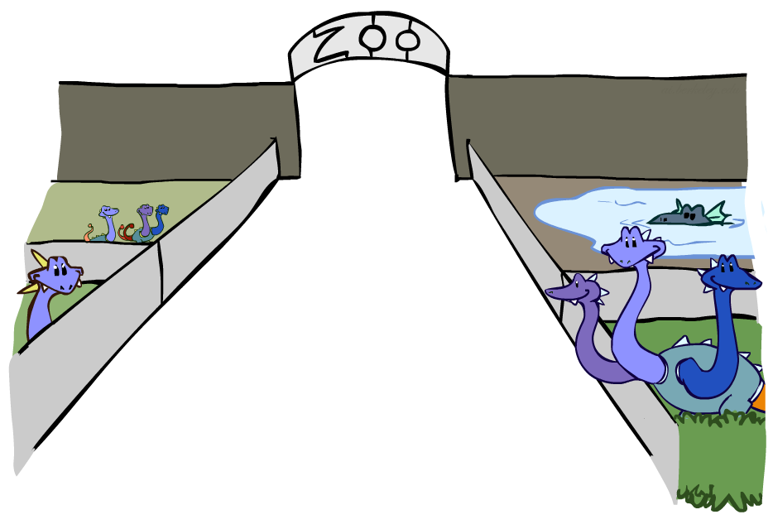
Factor Zoo

Slide 6

Factor Zoo I
Joint distribution: P(X,Y)
Entries P(x,y) for all x, y
|X|x|Y| matrix
Sums to 1
Projected joint: P(x,Y)
A slice of the joint distribution
Entries P(x,y) for one x, all y
|Y|-element vector
Sums to P(x)
P(A,J)
A \ J | true | false
true | 0.09 | 0.01
false | 0.045 | 0.855
P(a,J) = P_{a}(J)
A \ J | true | false
true | 0.09 | 0.01
Number of variables (capitals) = dimensionality of the table

Slide 7


Factor Zoo II
P(J|a)
Single conditional: P(Y | x)
Entries P(y | x) for fixed x, all y
Sums to 1
Family of conditionals:
P(X |Y)
Multiple conditionals
Entries P(x | y) for all x, y
Sums to |Y|
A \ J | true | false
true | 0.9 | 0.1
P(J|A)
A \ J | true | false
true | 0.9 | 0.1
false | 0.05 | 0.95
} - P(J|a)
} - P(J|¬a)

Slide 8

Operation 1: Pointwise product
First basic operation: pointwise product of factors (similar to a database join, not matrix multiply!)
New factor has union of variables of the two original factors
Each entry is the product of the corresponding entries from the original factors
Example: P(J|A) x P(A) = P(A,J)
P(J|A)
P(A,J)
P(A)
A \ J | true | false
true | 0.9 | 0.1
false | 0.05 | 0.95
A \ J | true | false
true | 0.09 | 0.01
false | 0.045 | 0.855
true | 0.1
false | 0.9
x
=

Slide 9

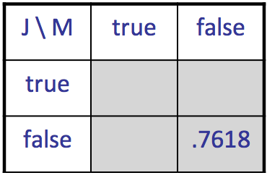
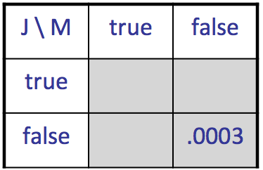
Example: Making larger factors
Example: P(A,J) x P(A,M) = P(A,J,M)
P(A,J,M)
P(A,J)
P(A,M)
A \ J | true | false
true | 0.09 | 0.01
false | 0.045 | 0.855
A \ M | true | false
true | 0.07 | 0.03
false | 0.009 | 0.891
x
=
A=false
A=true

Slide 10
Example: Making larger factors
Example: P(U,V) x P(V,W) x P(W,X) = P(U,V,W,X)
Sizes: [10,10] x [10,10] x [10,10] = [10,10,10,10]
I.e., 300 numbers blows up to 10,000 numbers!
Factor blowup can make VE very expensive

Slide 11

Operation 2: Summing out a variable
Second basic operation: summing out (or eliminating) a variable from a factor
Shrinks a factor to a smaller one
Example: ∑_{j} P(A,J) = P(A,j) + P(A,¬j) = P(A)
P(A,J)
P(A)
A \ J | true | false
true | 0.09 | 0.01
false | 0.045 | 0.855
Sum out J
true | 0.1
false | 0.9

Slide 12
Summing out from a product of factors
Project the factors each way first, then sum the products
Example: ∑_{a} P(a|B,e) x P(j|a) x P(m|a)
= P(a|B,e) x P(j|a) x P(m|a) +
P(¬a|B,e) x P(j|¬a) x P(m|¬a)

Slide 13

Variable Elimination

Slide 14
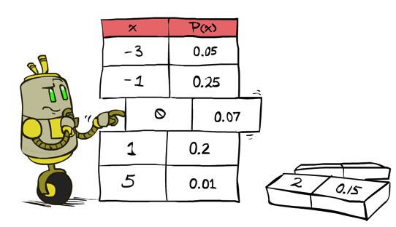
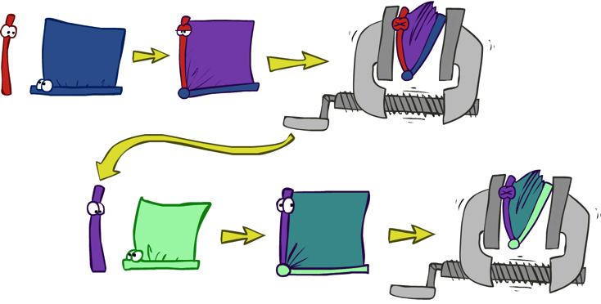

Variable Elimination
Query: P(Q|E₁=e₁,.., E_{k}=e_{k})
Start with initial factors:
Local CPTs (but instantiated by evidence)
While there are still hidden variables (not Q or evidence):
Pick a hidden variable H_{j}
Eliminate (sum out) H_{j} from the product of all factors mentioning H_{j}
Join all remaining factors and normalize
X α

Slide 15
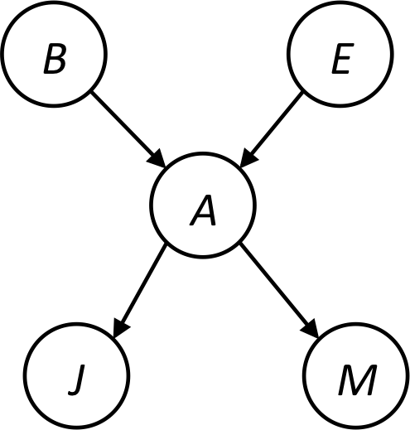


Example
Query P(B | j,m)
P(B) P(E) P(A|B,E) P(j|A) P(m|A)
Choose A
P(A|B,E)
P(j|A)
P(m|A)
P(j,m|B,E)
P(B) P(E) P(j,m|B,E)

Slide 16
Example
P(B) P(E) P(j,m|B,E)
Choose E
P(E)
P(j,m|B,E)
P(j,m|B)
P(B) P(j,m|B)
Finish with B
P(B)
P(j,m|B)
P(j,m,B)
Normalize
P(B | j,m)

Slide 17
Order matters
Z
Order the terms Z, A, B C, D
P(D) = α ∑_{z,a,b,c} P(z) P(a|z) P(b|z) P(c|z) P(D|z)
= α ∑_{z} P(z) ∑_{a} P(a|z) ∑_{b} P(b|z) ∑_{c} P(c|z) P(D|z)
Largest factor has 2 variables (D,Z)
Order the terms A, B C, D, Z
P(D) = α ∑_{a,b,c,z} P(a|z) P(b|z) P(c|z) P(D|z) P(z)
= α ∑_{a} ∑_{b} ∑_{c} ∑_{z} P(a|z) P(b|z) P(c|z) P(D|z) P(z)
Largest factor has 4 variables (A,B,C,D)
In general, with n leaves, factor of size 2^{n}
A
B
C
D

Slide 18
Example Bayes’ Net: Car Insurance
Enumeration: 227M operations
Elimination: 221K operations

Slide 19
Computational and Space Complexity
The computational and space complexity of variable elimination is determined by the largest factor (and it’s space that kills you)
The elimination ordering can greatly affect the size of the largest factor.
E.g., ZABCD example 2^{n} vs. 2
Does there always exist an ordering that only results in small factors?
No!

Slide 20
Worst Case Complexity? Reduction from SAT
0.5
0.5
0.5
0.5
Variables: W, X, Y, Z
CNF clauses:
C₁ = W v X v Y
C₂ = Y v Z v ¬W
C₃ = X v Y v ¬Z
Sentence S = C₁ ∧ C₂ ∧ C₃
P(S) > 0 iff S is satisfiable
=> NP-hard
P(S) = K x 0.5^{n} where K is the number of satisfying assignments for clauses
=> #P-hard
W
X
Y
Z
¬
¬
C₁
C₂
C₃
S
Notes:
Make this model simpler (no reason for fan-in constraint)

Slide 21
Polytrees
A polytree is a directed graph with no undirected cycles
For poly-trees the complexity of variable elimination is linear in the network size if you eliminate from the leaves towards the roots

Slide 22
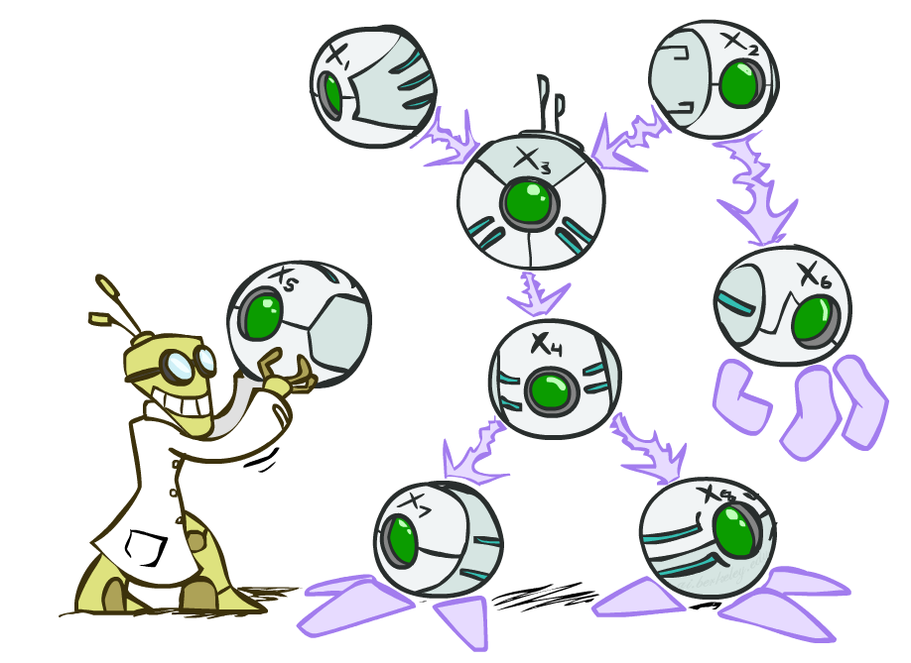
Summary
Exact inference = sums of products of conditional probabilities from the network
Enumeration is always exponential
Variable elimination reduces this by avoiding the recomputation of repeated subexpressions
Massive speedups in practice
Linear time for polytrees
Exact inference is #P-hard
Next: approximate inference

